Slide 1
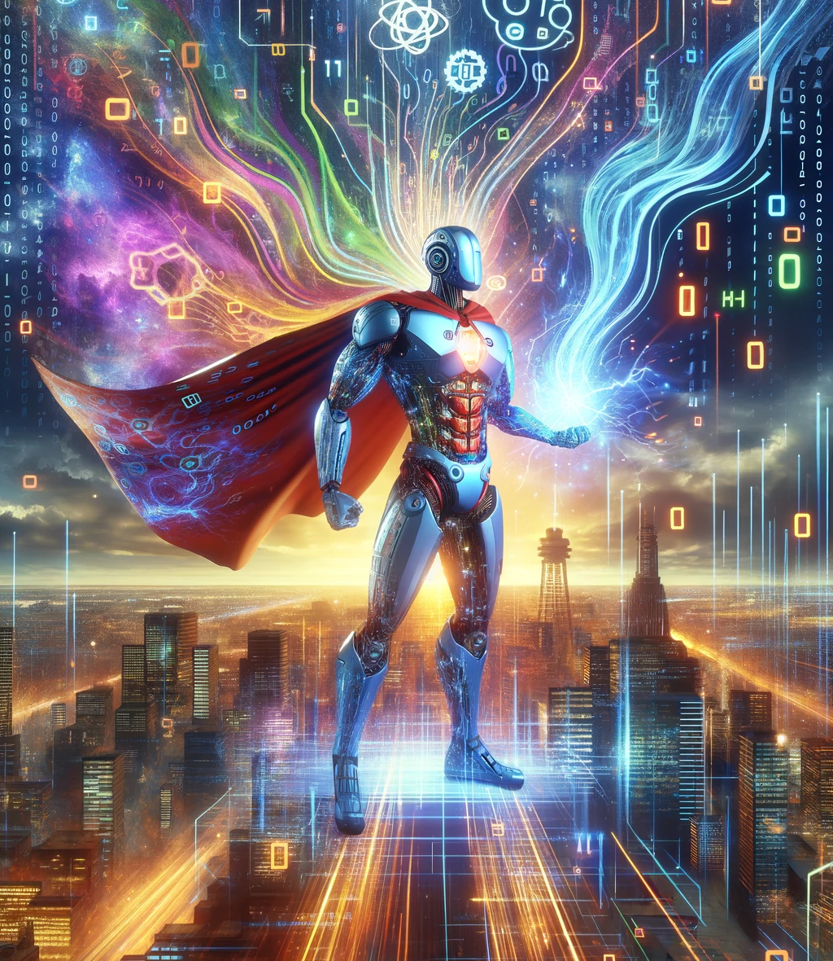
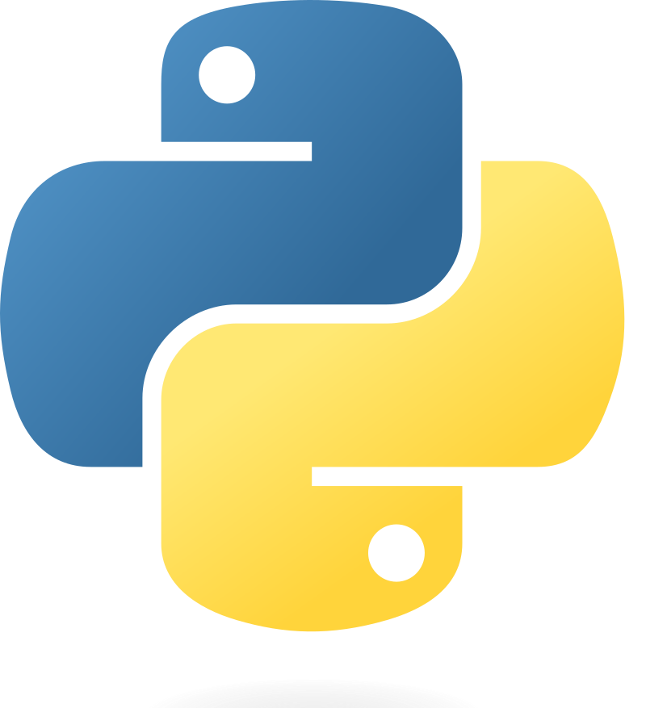

Implementing Transformer with Python & PyTorch
Quang Duong

Slide 2
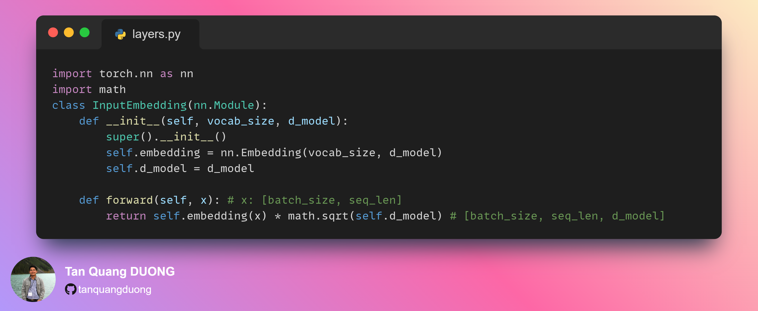
Input Embedding

Slide 3
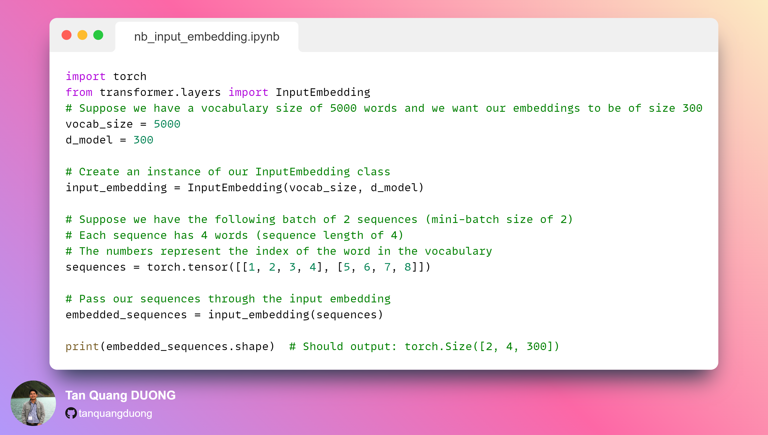
Input Embedding Notebook

